Slide 1
Query taxonomy

Slide 2
Classification of requirements
Beginning by listing the different service’s characteristics, which can be defined by the user as his/her requirements:
Availability
Response time
Price per call
Authentication
Privacy
Confidentiality
Data type
Degree of rawness
Veracity
Production time
Production rate
Provenance
Freshness
Trust

Slide 3
Classification of requirements
Separating requirements associated to the service provided and the ones associated to the data provided:
Service’s quality aspects:
Availability
Response time
Price per call
Authentication
Privacy & Confidentiality
Provenance
Data quality aspects:
Degree of rawness
Veracity
Production time
Production rate
Data type
Freshness
Trust

Slide 4
Classification of requirements
Questions/Doubts
Separating requirements associated to the service provided and the ones associated to the data provided:
Service’s quality aspects:
Availability
Response time
Price per call
Authentication
Privacy & Confidentiality
Provenance
Data quality aspects:
Degree of rawness
Veracity
Production time
Production rate
Data type
Freshness
Trust
Trust and veracity: I think that they denote the same aspect which is if you can trust or not the data. Don’t they?
Production time and rate : I am not sure if the user can be so specific concerning this aspect. In fact I think that based on the production time and rate the data provider will define the freshness value of his service. Probably the user will be specific about the freshness but not in these two measures.

Slide 5
Classification of requirements
Depending on your comments concerning the previous slide, I can add or not the other requirements here.
Considering the list of requirements below in which I removed or merged the requirements marked in the previous slide:
Service’s quality aspects:
Availability
Response time
Price per call
Authentication
Privacy & Confidentiality
Provenance
Data quality aspects:
Degree of rawness
Veracity
Data type
Freshness

Slide 6
Classification of requirements
I organized them in a priority list:
(i) Veracity
(ii) Freshness, provenance
(iii) Data type, degree of rawness, privacy & confidentiality
(iv) Price per call
Availability, response time, authentication
The idea is to use this priority to identify the cases in which the set of requirements are more, less restrict or the situation that is impossible to determine.

Slide 7
Classification of requirements
Like the heuristics approaches for selecting services and best compositions, I think we should have a formula to calculate the ‘quality score’ of services and compositions/queries.
Then based on this score, the cases in which we have different requirements, for example when there are requirements that their evaluation is contained in the evaluation of the new requirements and also there are requirements that their evaluation contains the evaluation of the new requirements.
In this sense, if the score of a first query is higher than a second one, this means that this first is more restrictive than the second according to the quality aspects.
This formula should take into account the priority of requirements for example given higher weights to the requirements with higher priority

Slide 8
Quality score of a service
The quality attribute can be positive (as higher, better) and negative (as lower, better)
Then according to type of attribute we need to normalize them between 0 and 1, where 1 is the best value and 0 the worst.
For positive attributes the quality score is calculated as follows:
(Qi – Qmin) / (Qmax – Qmin), where Qi is the value of a given attribute of a service, Qmax is the higher value associated to this attribute and the Qmin is the minimum value associated to this attribute
For negative attributes
(Qmax – Qi) / (Qmax – Qmin)

Slide 9
Quality score of a service
Once the score for each attribute is computed, we can calculate the final quality score of a service taking into consideration the priority of requirements, for example:
The final score S_{S1} is computed by adding the score of each attribute multiplied by his associated weight:
S_{S1}: S_{veracity} * w₁ + S_{freshness} * w₂ + S_{provenance} * w₂ + S_{data_type} * w₃ …
This final score could be used to sort the services which produces the same data from the ones with higher quality to the ones with lower quality.
There are requirements which are measured using ‘yes or no’, ‘certified and non-certified’ for these requirements we could associate a number to them to be able to compute the scores.

Slide 10
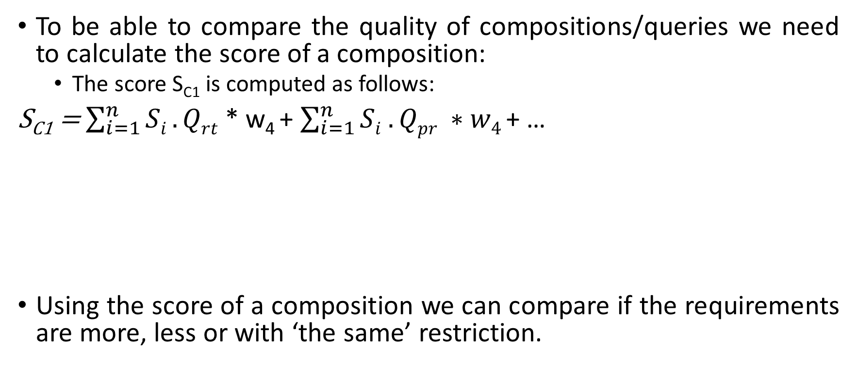
Quality score of a composition
To be able to compare the quality of compositions/queries we need to calculate the score of a composition:
The score S_{C1} is computed as follows:
S_{C1} = $\sum_{i=1}^{n}{Si .Qrt}$ * w₄ + $\sum_{i=1}^{n}{Si . Qpr} ∗w4$ + …
Using the score of a composition we can compare if the requirements are more, less or with ‘the same’ restriction.
Adding all quality attribute ‘response time (rt)’ and then mutiplying it by its weight.
Same with ‘price ’ and so on...
Depending on the measure I think it is not adding, for example the availability I think it is an average...

Slide 11
Query taxonomy
I think that comparing a previous query Qp with a new query Qn there are 4 types of query and a set of cases for each type:
Qn is equivalent to Qp
1. Qn and Qp denote to the same data and their requirements are equivalent
Qn is a subset of Qp
2. Qn and Qp denote to the same data and the requirements of Qn are more restrictive than the requirements of Qp
3. Qn denotes to a data which is a subset of Qp’s data and the requirements are equivalent
4. Qn denotes to a data which is a subset of Qp’s data and the requirements of Qn are more restrictive than the requirements of Qp
Qn is a superset of Qp
5. Qn and Qp denote to the same data and the requirements of Qn are less restrictive than the requirements of Qp
6. Qn denotes to a data which is a subset of Qp’s data and the requirements of Qn are less restrictive than the requirements of Qp
7. Qn denotes to a data which is a superset of Qp’s data and the requirements are equivalent
8. Qn denotes to a data which is a superset of Qp’s data and the requirements of Qn are more restrictive than the requirements of Qp
9. Qn denotes to a data which is a superset of Qp’s data and the requirements of Qn are less restrictive than the requirements of Qp
Qn is different of Qp

Slide 12
Query taxonomy: Qn is equivalent to Qp
Q_{p} (disease?, doctor?; p_information!) := A1 (disease?; p!), A3 (doctor?; p!), A2 (p?; p_information!),
{availability > 97%, response time < 3s, price per call < 0.2$, provenance = certified, freshness = no, total response time < 10s, total cost < 5$}
Q_{n} (disease?, doctor?; p_information!) := A1 (disease?; p!), A3 (doctor?; p!), A2 (p?; p_information!),
{availability > 97%, response time < 3s, price per call < 0.2$, provenance = certified, freshness = no, total response time < 10s, total cost < 5$}
A1
A2
A1
A2
A3
A3
1. Qn and Qp denote to the same data and their requirements are equivalent

Slide 13
Query taxonomy: Qn is a subset of Qp
Q_{p} (disease?, doctor?; p_information!) := A1 (disease?; p!), A3 (doctor?; p!), A2 (p?; p_information!),
{availability > 97%, response time < 3s, price per call < 0.2$, provenance = certified, freshness = no, total response time < 10s, total cost < 5$}
Q_{n} (disease?, doctor?; p_information!) := A1 (disease?; p!), A3 (doctor?; p!), A2 (p?; p_information!),
{availability > 98%, response time < 3s, price per call < 0.1$, provenance = certified, freshness = yes, total response time < 10s, total cost < 5$}
A1
A2
A1
A2
A3
A3
2. Qn and Qp denote to the same data and the requirements of Qn are more restrictive than the requirements of Qp

Slide 14
Query taxonomy: Qn is a subset of Qp
Q_{p} (disease?, doctor?; p_information!) := A1 (disease?; p!), A3 (doctor?; p!), A2 (p?; p_information!),
{availability > 97%, response time < 3s, price per call < 0.2$, provenance = certified, freshness = no, total response time < 10s, total cost < 5$}
Q_{n} (disease?, doctor?; p_information!) := A1 (disease?; p!), A3 (doctor?; p!), A4 (hospital?; p!), A2 (p?; p_information!),
{availability > 97%, response time < 3s, price per call < 0.2$, provenance = certified, freshness = no, total response time < 10s, total cost < 5$}
A1
A2
A1
A2
A4
A3
A4
A3
3. Qn denotes to a data which is a subset of Qp’s data and the requirements are equivalent

Slide 15
Query taxonomy: Qn is a subset of Qp
Q_{p} (disease?, doctor?; p_information!) := A1 (disease?; p!), A3 (doctor?; p!), A2 (p?; p_information!),
{availability > 97%, response time < 3s, price per call < 0.2$, provenance = certified, freshness = no, total response time < 10s, total cost < 5$}
Q_{n} (disease?, doctor?; p_information!) := A1 (disease?; p!), A3 (doctor?; p!), A4 (hospital?; p!), A2 (p?; p_information!),
{availability > 98%, response time < 2s, price per call < 0.2$, provenance = certified, freshness = no, total response time < 10s, total cost < 5$}
A1
A2
A1
A2
A4
A3
A4
A3
4. Qn denotes to a data which is a subset of Qp’s data and the requirements of Qn are more restrictive than the requirements of Qp

Slide 16
Query taxonomy: Qn is a superset of Qp
Q_{p} (disease?, doctor?; p_information!) := A1 (disease?; p!), A3 (doctor?; p!), A2 (p?; p_information!),
{availability > 97%, response time < 3s, price per call < 0.2$, provenance = certified, freshness = no, total response time < 10s, total cost < 5$}
Q_{n} (disease?, doctor?; p_information!) := A1 (disease?; p!), A3 (doctor?; p!), A2 (p?; p_information!),
{availability > 97%, response time < 5s, price per call < 0.2$, provenance = certified, freshness = no, total response time < 10s, total cost < 5$}
A1
A2
A1
A2
A3
A3
5. Qn and Qp denote to the same data and the requirements of Qn are less restrictive than the requirements of Qp

Slide 17
Query taxonomy: Qn is a superset of Qp
Q_{p} (disease?, doctor?; p_information!) := A1 (disease?; p!), A3 (doctor?; p!), A2 (p?; p_information!),
{availability > 97%, response time < 3s, price per call < 0.2$, provenance = certified, freshness = no, total response time < 10s, total cost < 5$}
Q_{n} (disease?, doctor?; p_information!) := A1 (disease?; p!), A3 (doctor?; p!), A4 (hospital?; p!), A2 (p?; p_information!),
{availability > 97%, response time < 3s, price per call < 0.3$, provenance = certified, freshness = no, total response time < 10s, total cost < 5$}
A1
A2
A1
A2
A4
A3
A4
A3
6. Qn denotes to a data which is a subset of Qp’s data and the requirements of Qn are less restrictive than the requirements of Qp
I don’t think it is a superset, but I don’t know how to classify this case.

Slide 18
Query taxonomy: Qn is a superset of Qp
Q_{p} (disease?, doctor?; p_information!) := A1 (disease?; p!), A3 (doctor?; p!), A2 (p?; p_information!),
{availability > 97%, response time < 3s, price per call < 0.2$, provenance = certified, freshness = no, total response time < 10s, total cost < 5$}
Q_{n} (disease?; p_information!) := A1 (disease?; p!), A2 (p?; p_information!),
{availability > 97%, response time < 3s, price per call < 0.2$, provenance = certified, freshness = no, total response time < 10s, total cost < 5$}
A1
A2
A1
A2
A3
A3
7. Qn denotes to a data which is a superset of Qp’s data and the requirements are equivalent

Slide 19
Query taxonomy: Qn is a superset of Qp
Q_{p} (disease?, doctor?; p_information!) := A1 (disease?; p!), A3 (doctor?; p!), A2 (p?; p_information!),
{availability > 97%, response time < 3s, price per call < 0.2$, provenance = certified, freshness = no, total response time < 10s, total cost < 5$}
Q_{n} (disease?; p_information!) := A1 (disease?; p!), A2 (p?; p_information!),
{availability > 98%, response time < 2s, price per call < 0.2$, provenance = certified, freshness = no, total response time < 10s, total cost < 5$}
A1
A2
A1
A2
A3
A3
8. Qn denotes to a data which is a superset of Qp’s data and the requirements of Qn are more restrictive than the requirements of Qp

Slide 20
Query taxonomy: Qn is a superset of Qp
Q_{p} (disease?, doctor?; p_information!) := A1 (disease?; p!), A3 (doctor?; p!), A2 (p?; p_information!),
{availability > 97%, response time < 3s, price per call < 0.2$, provenance = certified, freshness = no, total response time < 10s, total cost < 5$}
Q_{n} (disease?; p_information!) := A1 (disease?; p!), A2 (p?; p_information!),
{availability > 97%, response time < 4s, price per call < 0.2$, provenance = certified, freshness = no, total response time < 10s, total cost < 5$}
A1
A2
A1
A2
A3
A3
9. Qn denotes to a data which is a superset of Qp’s data and the requirements of Qn are less restrictive than the requirements of Qp

Slide 21
Questions concerning the slides of Genoveva:
Why did you reason about the data providers? In a previous meeting you said to do not reason about the data providers.
I did not understand the new axis.
For the first example, should be contained in both senses, shouldn’t be?
For the second case, instead of « instersects » should it be a « subset »?

